Slide 1

Hypothesis testing
DATA ANALYTICS | IRONHACK

Slide 2


HYPOTHESIS TEST
A hypothesis test is an statistical analysis which uses one sample of our population to asses two mutually exclusive theories about the population, named:
Null Hypothesis: H0
Alternate Hypothesis: H1
Ho
Ha

Slide 3
ELEMENTS OF HYPOTHESIS TESTS
The elements needed to conduct this type of analysis are:
Null hypothesis: H0
Alternate hypothesis: H1
Confidence level (1- α ) or significance level ( α )
Test statistic ( value computed the sample, different in every test )
P-value

Slide 4
NULL HYPOTHESIS:
The H0 hypothesis is the basic assumption the we want to validate/reject.
Is one of the two mutually exclusive theories about the population properties.
The H0 depends on the test. Every kind of test has a different H0.

Slide 5
ALTERNATE HYPOTHESIS:
H1: the opposite of the null hypothesis.

Slide 6
CONFIDENCE AND SIGNIFICANCE LEVEL:
Significance level ( α ): How strong has to be the sample evidence to conclude that there null hypothesis can be rejected.
Ex: in a criminal court, the null hypothesis is:
H0: the accused is innocent unless (police finds strong enough evidences to reject the null hypothesis)
H1: the accused is guilty.
Confidence level ( 1 - α ): Likelihood of finding a value as extreme as the one we have.

Slide 7
WAYS TO CONDUCT A STATISTICAL TEST:
There are two ways to conduct an statistical test:
Computing the test statistic from our sample and comparing it against the critical value/s corresponding to the given significance level.
Comparing the p-value (area) from our sample and comparing it against the significance level (maximum area)

Slide 8
HYPOTHESIS TESTING STEPS: USING THE TEST STATISTIC:
Fix the confidence level/significance level.
Compute the test statistic.
Compute the critical value/s of the test’s distribution.
Compare the test statistic against the critical value/s.
If the test statistic is in the allowed region, (the size of allowed region is determined by the confidence level, whereas the location of rejection region is determined by the alternate hypotheses) accept the null hypothesis, otherwise reject the it.
The allowed region depends on the type of test.

Slide 9
HYPOTHESIS TESTING USING THE P-VALUE:
P-VALUE = P( D | HO ) = What is the probability to obtain our data, when the null hypothesis is True.
Set your significance level.
Get your p-value.
Compare your p-value against your significance level alpha.
P-value <= alpha -> reject the null hypothesis H0
P-value > alpha -> accept the null hypothesis H0

Slide 10
EQUIVALENCE BETWEEN THE CRITICAL VALUE AND THE P-VALUE APPROACHES:
When we fix our confidence level, we’re fixing the probability of getting a difference a between our sample value and the reference value.
The significance level is the complementary of the previous probability.
The critical value, the value for which the probability of getting any value smaller or equal to it is equal to the confidence level.
The p-value is the probability of getting any value higher than the the critical value.

Slide 11
THE CENTRAL LIMIT THEOREM
According to this theorem, the the sampling distribution ( the distribution of all the samples means) follows a normal distribution centered around the population mean ( regardless of the original population distribution)
Therefore, if we subtract the mean of our sample from the population mean, the resulting values will follow a normal distribution centered on 0. ( If we subtract two random variables which follow a normal distribution, the resulting value follows a normal distribution )
If we divide the previous values by the standard error of the mean, then the resulting distribution will be a normal distribution with mean = 0 and standard deviation = 1
We can use this to determine the probability to get a sample mean which deviates from our population mean as much as our sampling error.

Slide 12
THE CORE IDEA OF HYPOTHESIS TESTING
We know that the means of the samples, follow a normal distribution centered on the population mean.
The sample mean will almost never be identical to the population mean. This difference is called sampling error.
We can use this fact in order to evaluate how likely is to get a sample with a mean which deviates from the population mean as much as the sampling error.
Based on the probability of getting our sampling error we will decide if we accept or reject the null Hypothesis.
For that, we will have to set how unlikely should be to get a sampling error to reject the null hypothesis (our threshold of likelihood).

Slide 13
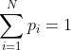
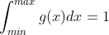
COMPUTING PROBABILITIES:
Discrete:
Continuous:

Slide 14
COMPUTING CUMULATIVE PROBABILITIES: CUMULATIVE DISTRIBUTION FUNCTION (CDF)
The cumulative distribution function give us what is the total probability of getting any value smaller or equal to a given value.

Slide 15
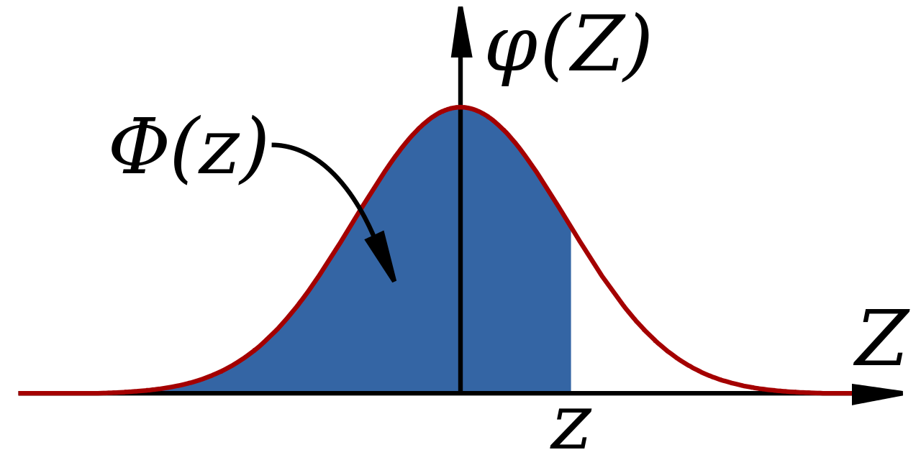
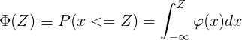
COMPUTING CONTINUOUS PROBABILITIES: CDF
This function gives the probability to get ANY value below or equal to a given one ( confidence level = 1- α ) (significance level = α ) for a given distribution.
1- α
α

Slide 16
PPF:
This function give us what is the total probability of all the values smaller or equal than a given value
P(x <z) =?

Slide 17

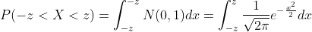
COMPUTING PROBABILITIES FOR THE NORMAL
Given a normal distribution, we can also be interested in knowing how what is the probability to sample a value which deviates from 0 a given amount z.
Use the symmetry of the distribution in your favor.

Slide 18
STATISTICAL TESTS TYPES:
The one sample statistical tests can be broadly classified into:
One tailed test (one critical value)
Two tailed test (two critical values)
One-tailed hypothesis tests are also known as directional or one-sided tests because you can test for effects in only one direction.
Two-tailed hypothesis tests are also known as nondirectional or two-sided tests because you can test for effects in both directions.

Slide 19
STATISTICAL TESTS: REJECTION AREA
When we do an statistical test, we are evaluating how likely is to have a sample which deviates from the reference value in as much as the difference between the sample and the reference value, when the H0 is True.
The location of rejection area is determined by alternative hypothesis.
H1: sample_mean < reference_value -> The rejection area on the left hand side of the distribution
H1: sample_mean > reference_value -> The rejection area on the right hand side of the distribution.
H1: sample_mean != reference_value -> The rejection area on both sides of the distribution
Follow the arrow of the alternate hypothesis!

Slide 20
STATISTICAL TESTS SAMPLE SIZE:
If the sample size is smaller than 30: use the t-Student distribution with setting number of degrees of freedom = sample_size - 1
Otherwise you can safely use the normal distribution as the t-Student distribution and the normal distribution become almost identical.
Both distributions are symmetric around the center 0.
The t-Student distribution is more spiked at the center and it has longer tails.

Slide 21
ONE SAMPLE ONE TAILED TEST:
How big can be a value in order to a given amount of probability to get any value smaller or equal to it for a normal distribution?
Acceptation region
Rejection region = α
1- α
α
= Critical value

Slide 22
EXAMPLE: ONE SAMPLE, ONE TAILED TEST
Boys of a certain age are said to have a mean weight of μ >= 85 pounds.
A complaint is made that the boys living in a municipal children's home are underfeed. (μ < 85 pounds)
A sample of n = 25 boys (of the same age) are weighed and found to have a sample mean weight of 80.94 pounds.
It is known that the population standard deviation σ is 11.6 pounds
Based on the sample, can we say that the boys have a mean weight smaller than 85 pounds?
Our sampling error is (80.94 - 85) = -4.06 pounds. How likely is to get this value?

Slide 23
EXAMPLE: ONE SAMPLE, ONE SIDED TEST
What are the null and alternative hypotheses?
Null Hypothesis H0: μ >= 85 pounds.
Alternative Hypothesis: H1: μ < 85 pounds.:
We do not have the complete data from the population.
Therefore, we take a SAMPLE of 25 subjects < 30. As 25<30 we use t-Student dist.
Small sample sizes follow a t-student distribution with n - 1 degrees of freedom
The number of degrees of freedom บ is: n - 1 (sample size - 1, 24 in this case)
So based on this sample data we will try to prove or disprove our Hypothesis, using a statistical t-test.

Slide 24
EXAMPLE: ONE SAMPLE, ONE SIDED TEST
Steps for solving this problem:
Step1: Define the null hypothesis - This is our assumption about the population. It is defined by H0 and in this case H0: μ >= 85
Step 2: Define the alternative hypothesis- This means, what if our assumption is not true, inf fact the value is smaller.. It is defined by H1 and in this case H1: μ < 85

Slide 25
EXAMPLE: ONE SAMPLE, ONE SIDED TEST
In this case, our null hypothesis would be false only in one side of the distribution (when our sample mean - 85 < 0 , hence such a test is called a One sided Test,
Step 3: Determine the distribution to use. As the sample size is small ( n < 30 ), we will use the t-Student distribution.
Step 5: Set the Confidence level / significance level: This defines the rejection region / critical region (How strong has to be the evidence against the null hypothesis). Significance level is defined by greek letter ‘α’. Usual values for confidence level are ( 90%, 95%, 99%) -> significance levels = (0.10, 0.05, 0.01). Let’s use a confidence level of 95% -> α = 0.05

Slide 26
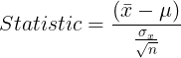
EXAMPLE: ONE SAMPLE, ONE SIDED TEST
Step 5: Calculate the t-test statistic based on the given information:
Yes
No
If you don’t have the population standard deviation, use the corrected sample standard deviation
Is the statistic within the
acceptable region?
Accept Ho (null hypothesis)
Reject Ho (null hypothesis)

Slide 27
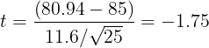
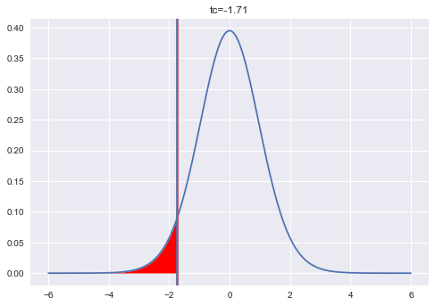
EXAMPLE: ONE SAMPLE, ONE SIDED TEST
In our case: . It’s important to note that is possible to get this negative value according to the t-Student distribution. But the key point is to know how unlikely is to get it!
Where is located the critical value of the t-student distribution with 24 degrees of freedom and an area of 0.05? -> tc = -1.71
tc = scipy.stats.t.ppf(0.05, df=24) = -1.71
Our t = -1.75 < - 1.71=tc-> reject null hypothesis
Children are underfeed.
Unshaded area = 0.95

Slide 28
BIGGER SAMPLE SIZE: ONE SAMPLE, ONE TAILED TEST
Boys of a certain age are known to have a mean weight of μ >= 85 pounds.
A complaint is made that the boys living in a municipal children's home are underfeed. (μ < 85 pounds)
Now, we take a bigger sample of n = 50 boys (of the same age) who are weighed and found to have a sample mean weight of 80.94 pounds. We use the t-Student distrib but we can use the normal distrib.
It is known that the population standard deviation σ is 11.6 pounds
Based on the available data, what should be concluded concerning the complaint?

Slide 29
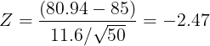
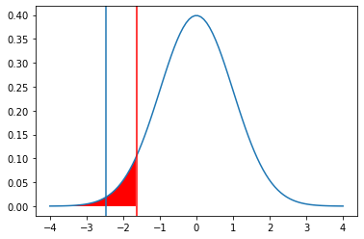
EXAMPLE: ONE SAMPLE, ONE TAILED TEST
In our case:
Where is located the critical value of the normal distribution with an area of 0.05? -> zc = -1.64
zc = scipy.stats.norm.ppf(0.05) = -1.64
Our z = -2.47 < - 1.64 = zc -> reject null hypothesis
Children are underfeed.

Slide 30
EXAMPLE: ONE SAMPLE, TWO TAILED TEST
Boys of a certain age are known to have a mean weight of μ = 85 pounds.
A complaint is made that the boys living in a municipal children's home have a different average weight. (μ != 85 pounds)
A sample of n = 25 boys (of the same age) are weighed and found to have a sample mean weight of 80.94 pounds.
It is known that the population standard deviation σ is 11.6 pounds
Based on the available data, what should be concluded concerning the complaint?

Slide 31
ONE SAMPLE, TWO TAILED TEST
Two-tailed test is a method to tests whether a sample is greater than or less than a certain range of values.
Ex:
Null Hypothesis: Ho -> μ = 85 pounds
Alternate hypothesis: Ha -> μ != 85 pounds
The discrepancy can take at both sides of the distribution! Our sample mean can be bigger or smaller than the theoretical value.

Slide 32
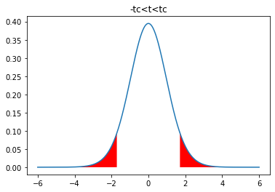
EXAMPLE: TWO SIDED TEST
Acceptance
region
Now, our value can be bigger or smaller than the population value. Therefore, the “rejection region” has to be shared at both sides!
α/2
1-α
α/2
Where are the vertical bars located?

Slide 33
EXAMPLE: ONE SAMPLE, TWO SIDED TEST
Step 5: Calculate the test statistic based on the given information:
Yes
No
If you don’t have the population standard deviation, use the corrected sample standard deviation
Is the statistic within the
acceptable region?
Accept Ho (null hypothesis)
Reject Ho (null hypothesis)

Slide 34
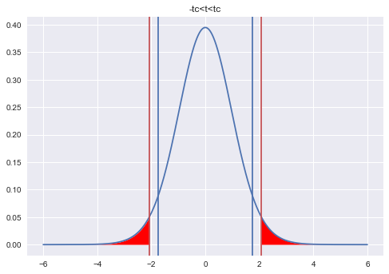
EXAMPLE: ONE SAMPLE, TWO SIDED TEST
In our case:
Where is located the critical value of the t-student distribution with 24 degrees of freedom and an area of 0.95? -> tc = 2.06
tc = +-scipy.stats.t.ppf(1-(0.05/2)=0.975,df=24)
Now, tc = -2.06 < -1.75 = t-> accept null hypothesis
Children have the mentioned average weight.

Slide 35
EXAMPLE: ONE SAMPLE, TWO TAILED TEST
Boys of a certain age are known to have a mean weight of μ = 85 pounds.
A complaint is made that the boys living in a municipal children's home are underfeed. (μ != 85 pounds)
Now we pick a bigger sample of n = 50 boys (of the same age) are weighed and found to have a sample mean weight of 80.94 pounds.
It is known that the population standard deviation σ is 11.6 pounds
Based on the available data, what should be concluded concerning the complaint?

Slide 36
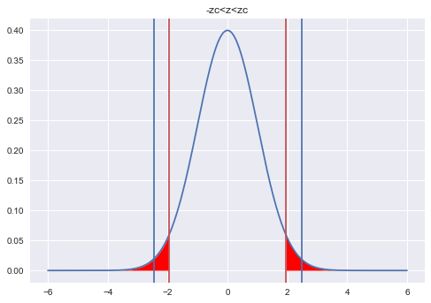
EXAMPLE: ONE SAMPLE, ONE SIDED TEST
In our case:
Where is located the critical value of the normal distribution with an area of 0.95? -> zc = 1.96
zc = +-scipy.stats.norm.ppf(1-(0.05/2)=0.975)
Now Zc = -1.96 > Z= - 2.47 -> reject null hypothesis
Children don’t have the mentioned weight.

Slide 37


